Slide 1
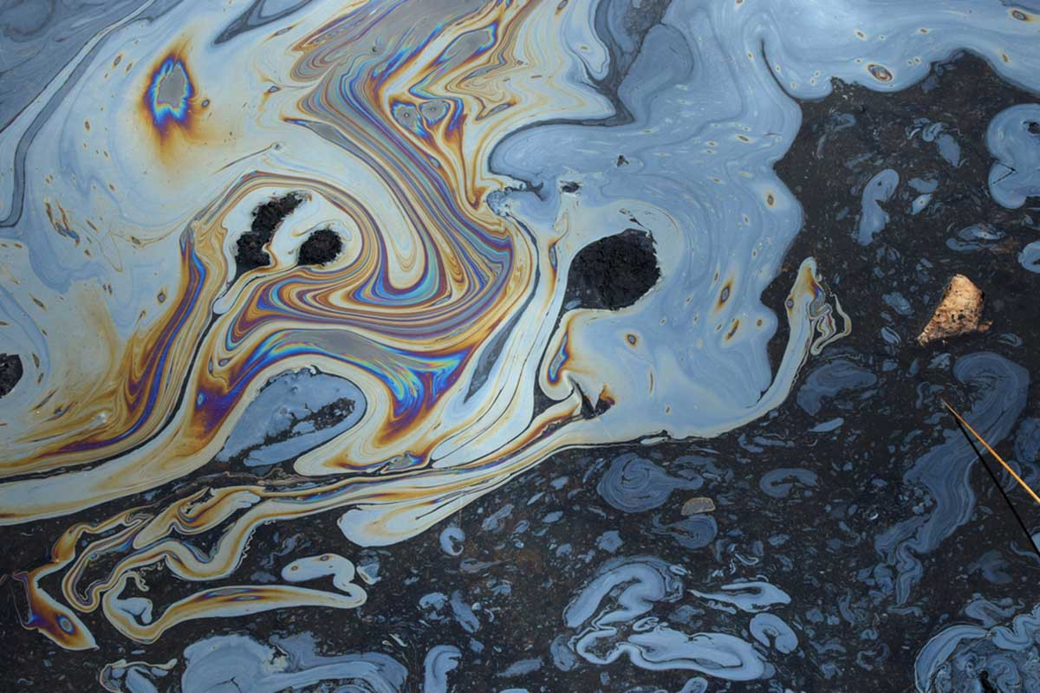

OIL SPILL DETECTION USING SEGMENTATION

Slide 2
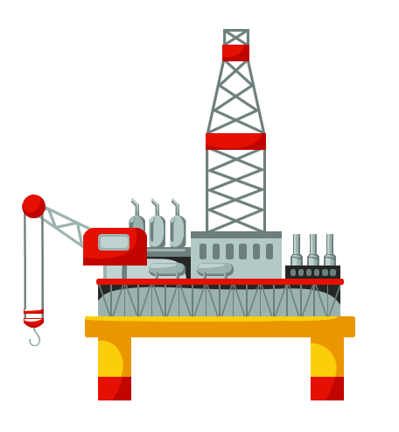
OUTLINE
Introduction
Problem Statement
Data
Architectures
Methodology
Evaluation and Results
Conclusion

Slide 3
PETROLEUM ENGINEERING
Oil Reserves
Treatment Facilities
The amount of crude oil that can be technically recovered at a cost that is financially feasible at the present price of oil.
Improvements used or installed at an oil and gas location for the exploration, production, withdrawal, gathering, treatment or processing of oil or natural gas
Surface Collection
Walking fields or other locations the surface of the ground are partially exposed or have been disturbed by plowing or natural processes of erosion
Drilling
Drilling is a cutting process that uses a drill bit to cut a hole of circular cross-section in solid materials
Transportation
Crude oil moves from wellhead to refinery using barges, tankers, over land, pipelines, trucks, and railroads. Natural gas is transported by pipelines and liquefied natural gas (LNG) tankers.

Slide 4
transportation
Pipelines
Oil Tankers
Pipelines play a very critical role in the transportation process because most of the oil moves through pipelines for at least part of the route. After the crude oil is separated from natural gas, pipelines transport the oil to another carrier or directly to a refinery.
Tank vessels are classified by the trade in which they routinely operate over a period of time. Tankers tend to remain in market even though the process to change a vessel's trade involves extensive work.
LNG Tankers
Due to scientific advancements, natural gas can be turned to liquid at extremely low temperatures and transported as liquefied natural gas (LNG). LNG tankers are designed with double hulls.

Slide 5
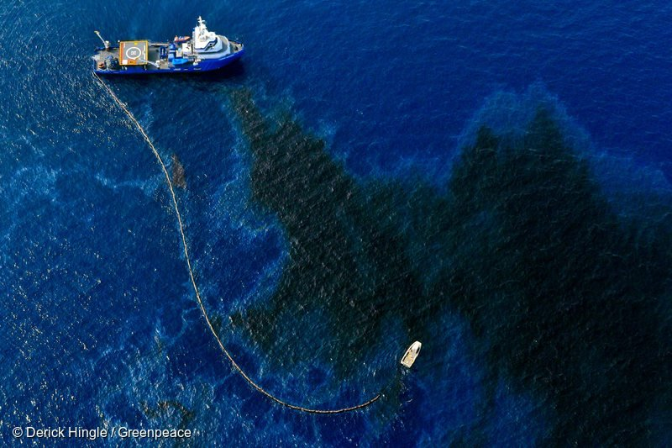
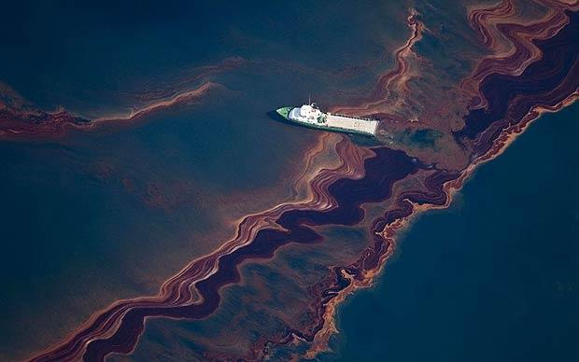
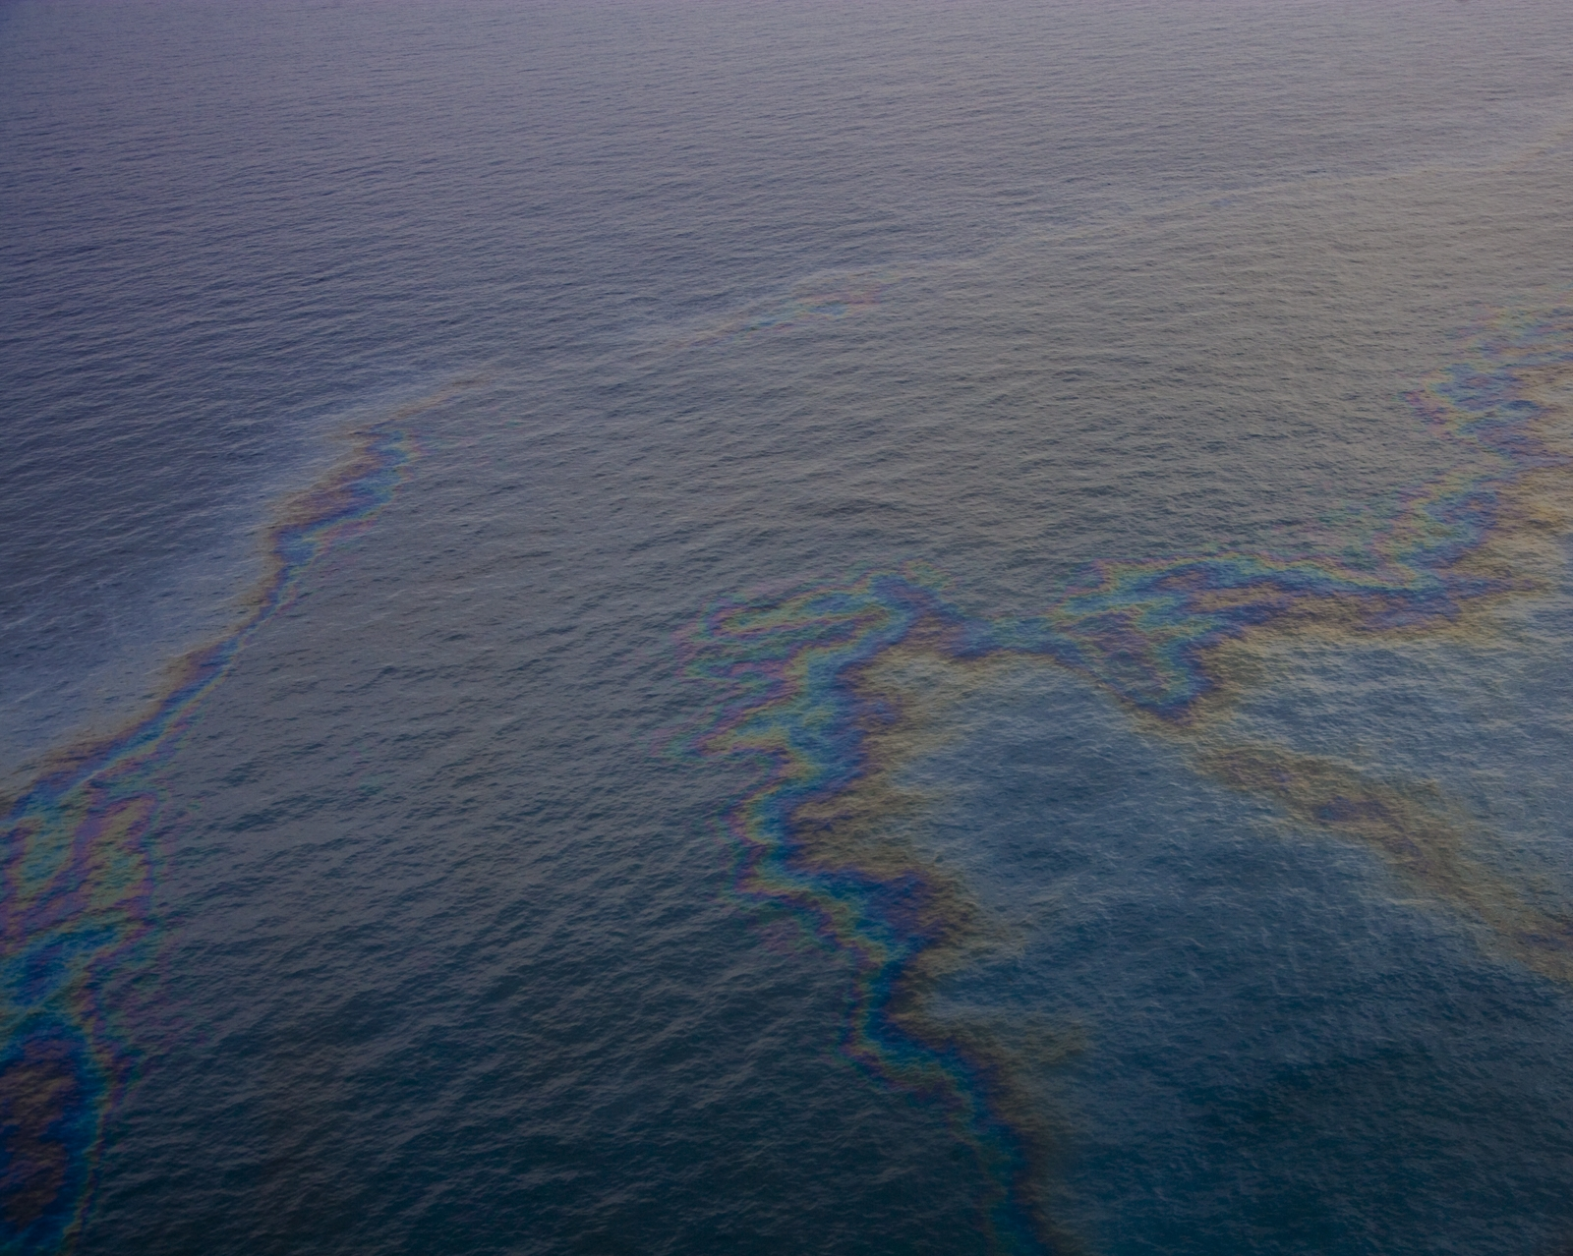
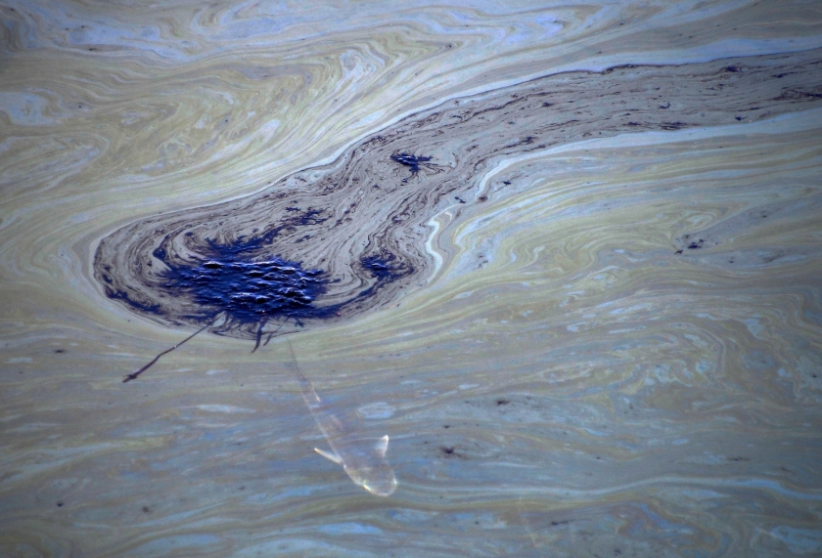
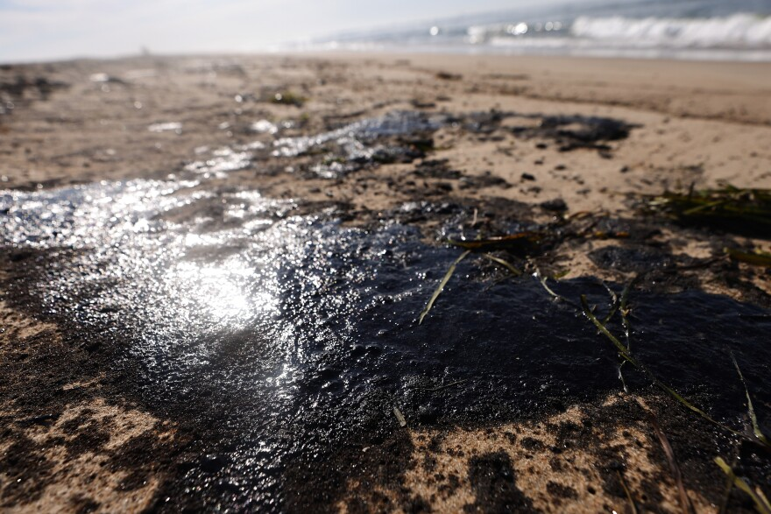
OILL SPILLS
Oil spills can be caused by human error, natural disasters, technical failures or deliberate releases.
It is estimated that 30-50% of all oil spills are directly or indirectly caused by human error, with approximately 20-40% of oil spills being attributed to equipment failure or malfunction.
12,000 – 15,000 oil spills are Reported annually in the US.
25 Gallons of oil can spread a visible sheen over an area of one square mile.

Slide 6
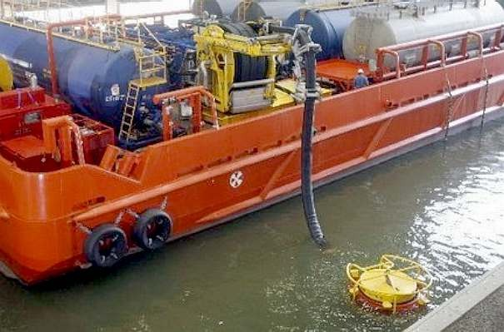
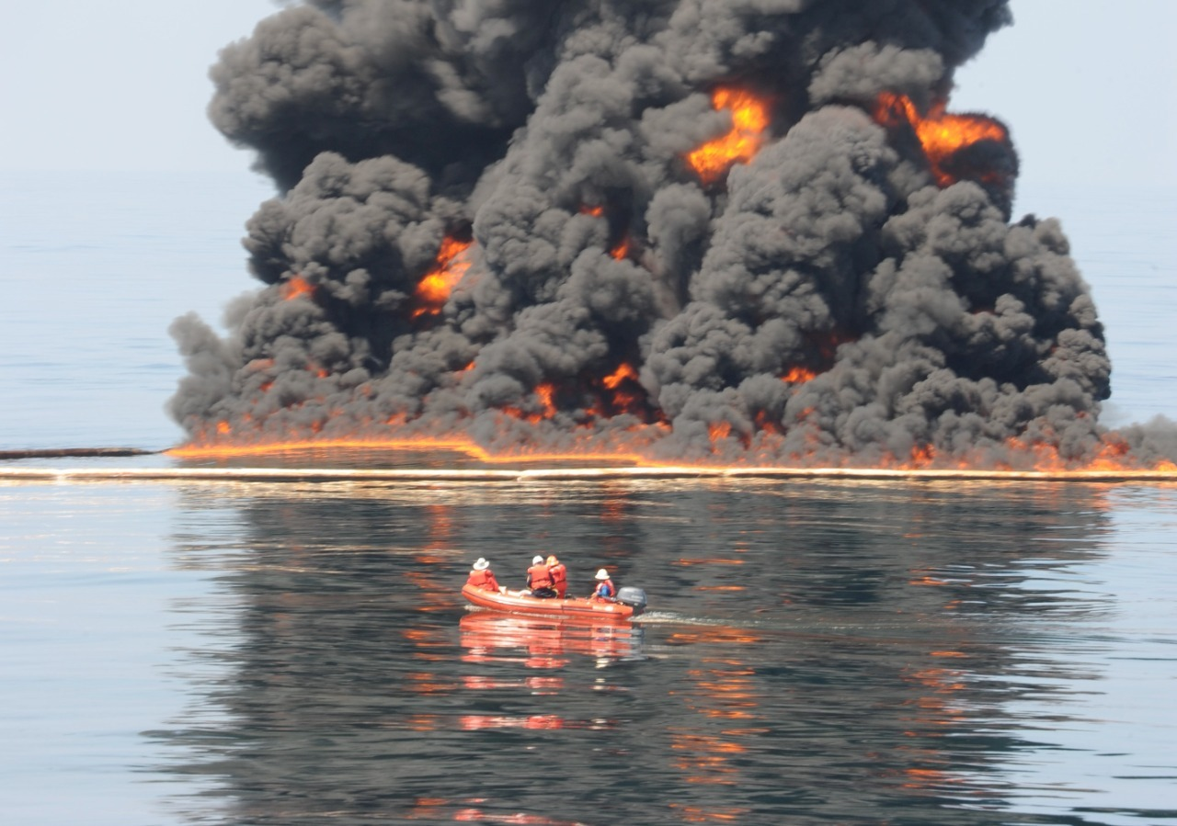
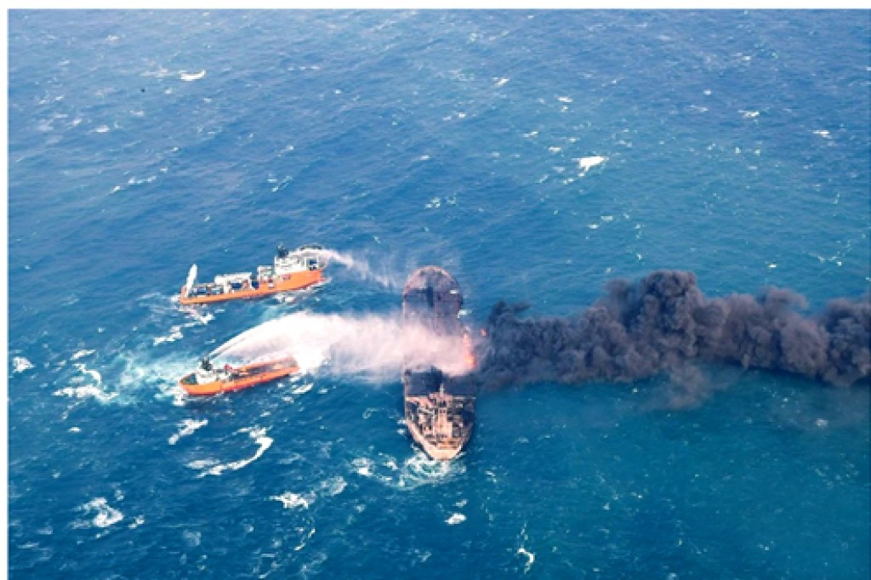
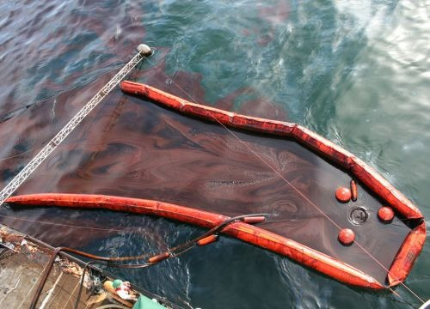
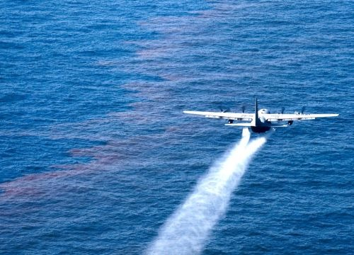
CLEANING UP OF OIL SPILLS?
Bioremediation
Skimming
Use of Dispersants
Vacuum and centrifuge
Controlled Burning

Slide 7
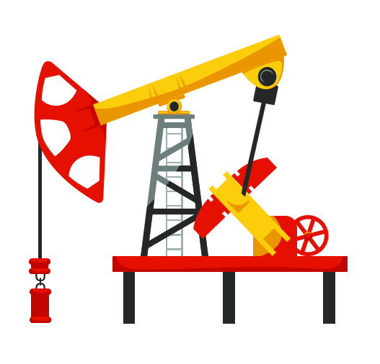
EARLY DETECTION OF SPILLS
Early warning and automated response capabilities allows early containment of oil pollution, thereby reducing the volume spilled.
Minimizing damage to the environment, wildlife, public waterways and/or commercial assets.
Prevention and early containment of spills benefits everyone: the public at large, stakeholders of watersheds and waterways, business interests the ecology of natural habitats, and the environment as a whole.
Notes:
3:10

Slide 8
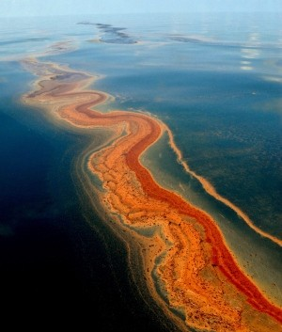
LARGEST MARINE OIL SPILLS
On June 8, 1990, an explosion of the tanker Mega Borg 60 miles off Galveston, Texas spilled over 5.1 million gallons of oil.
In 1989, the Exxon Valdez oil tanker ran aground in the Prince William Sound in Alaska, spilling over 11 million gallons of oil.
On Jan. 23, 2010, collision of the tanker Eagle Otome at Port Arthur, Texas. Approximately 462,000 gallons of oil had spilled into the ocean.

Slide 9
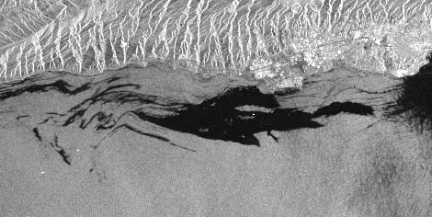
PROBLEM STATEMENT
The frequency of marine oil spills has increased in recent years. The growing exploitation of marine oil and continuous increase in marine crude oil transportation has tremendous damage to the marine ecological environment. It is one of the major causes of water pollution. Satellite images can improve the possibilities for the detection of oil spills as they cover large areas and offer an economical and easier way of continuous coast areas patrolling. Using Synthetic aperture radar (SAR) images, marine oil spills can be identified and controlled.

Slide 10
BIG DATA ANALYTICS
SME’s and Data Engineers
Data Collected from Sources
Machine Learning

Slide 11
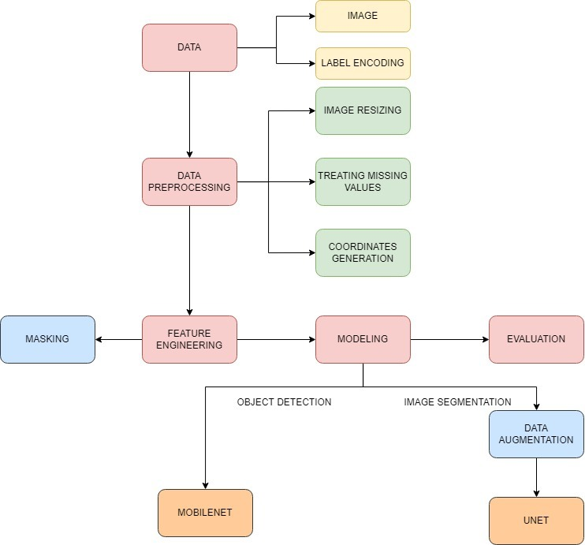
METHODOLOGY

Slide 12
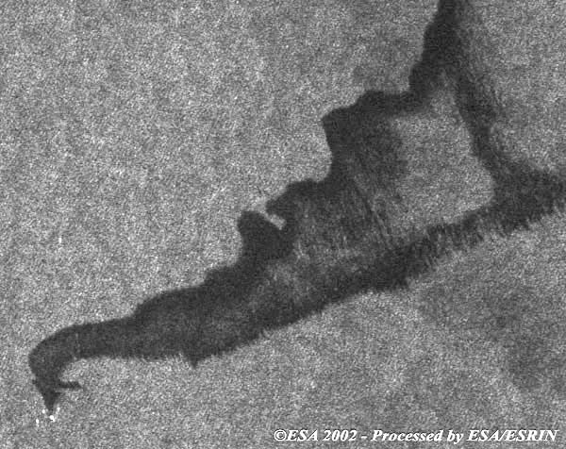
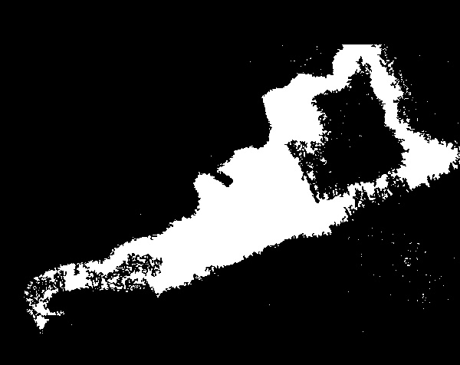
DATA PRE-PROCESSING
The dataset consists of Synthetic Aperture Radar images of oil spill during the accidents.
The dataset consists of unbalanced images with and without oils spills. They sum up to 200 images.
The coordinates of the oil spill are determined by mapping the bounding regions.
The images are of different dimensions which are resized to 96 X 96 for object detection and 256X256 for image segmentation.
The images are contoured for masking, by drawing polygons on oil spill region, thereby excluding the unnecessary regions.
Input for Recognition
Input for Segmentation (Mask)

Slide 13
APPROACHES
Object recognition is the ability to recognize a previously experienced object as familiar.
Object Recognition
Computer Vision
Image segmentation is termed as categorizing each pixel value of an image to a particular class.
Segmentation

Slide 14
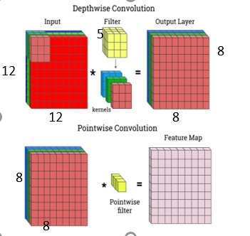
OBJECT RECOGNITION – MOBILENET V2
In object recognition, mobilenetv2 which is power to next generation computer vision neural networks developed by google is used.
It is a state of art architecture neural network that is specifically tailored for mobile and resource constrained environment.
MobileNetv2 builds upon the ideas from MobileNetv1, using depth wise separable convolution as efficient building blocks which is lighter than the previous architectures reducing the computational power.
Since MobileNetv2 has only 2.2M parameters, it trains faster than ResNet-50 (26M) and ResNext-101 (84M); as a tradeoff, the potential accuracy becomes lower.
8
8

Slide 15
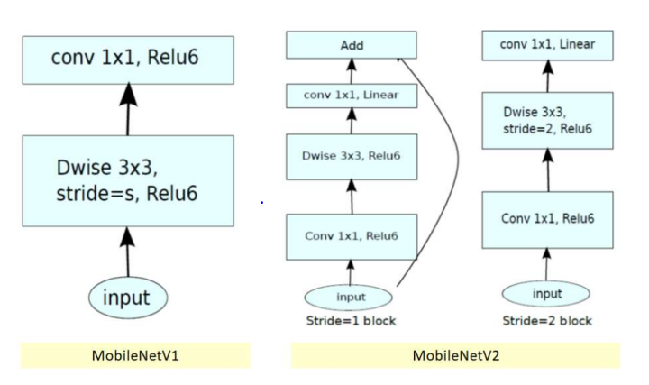
ARCHITECTURE
Architectural variation in MobileNetV1 and MobileNetV2

Slide 16
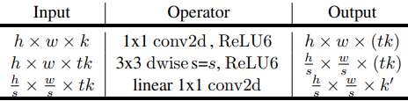
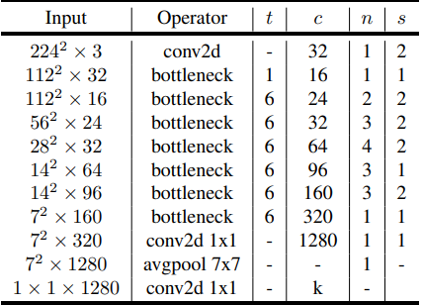
ARCHITECTURE
MobileNetv2's architecture includes a fully convolutional layer with 32 filters, and 19 residual bottleneck layers.
ReLu6 is used as a non-linearity (bottleneck) layer when used with low precision computation, because of its robustness.
3 X 3 kernel size, dropout and batch normalizations are used for training in modern networks.

Slide 17
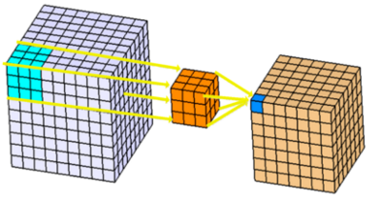
IMAGE SEGMENTATION - UNET
U-Net is a fast and accurate convolutional network designed for image segmentation.
U-Net localizes and distinguishes the abnormality in the image by classification on every pixel so the input and output are of same size and applies data augmentation techniques.
There are 23 convolutional layers, with each block in contraction path consisting of two, 3 X 3 convolutions, along with ReLu activation layer, followed by 2 X 2 max pooling
In the expansion layer, each block is composed of 1 De-convolution layer and two 3X3 convolution layer.

Slide 18

ARCHITECTURE
Concatenating with high-resolution feature maps from the Contraction Phase
Contraction Path:
Depth of the image increases
and loses Spatial Information
Expansion Path:
Increases the resolution of the output

Slide 19

MODELING
Object Recognition Model | MobileNetv2
Image Size | 96 X 96 X 1
Train-test ratio | 70:30
Optimizer | Adam
Learning rate | 0.01
Activation function | Soft max
Loss function | Binary focal loss
epochs | 5
Batch size | 3
Notes:
Optimization – rrecognition, adam, loss, accuracy, outputs,

Slide 20
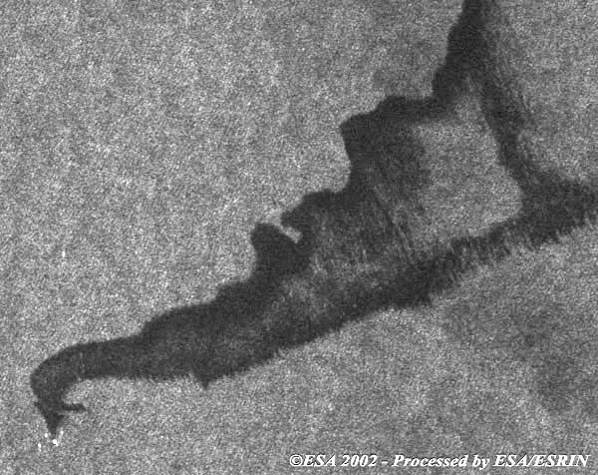
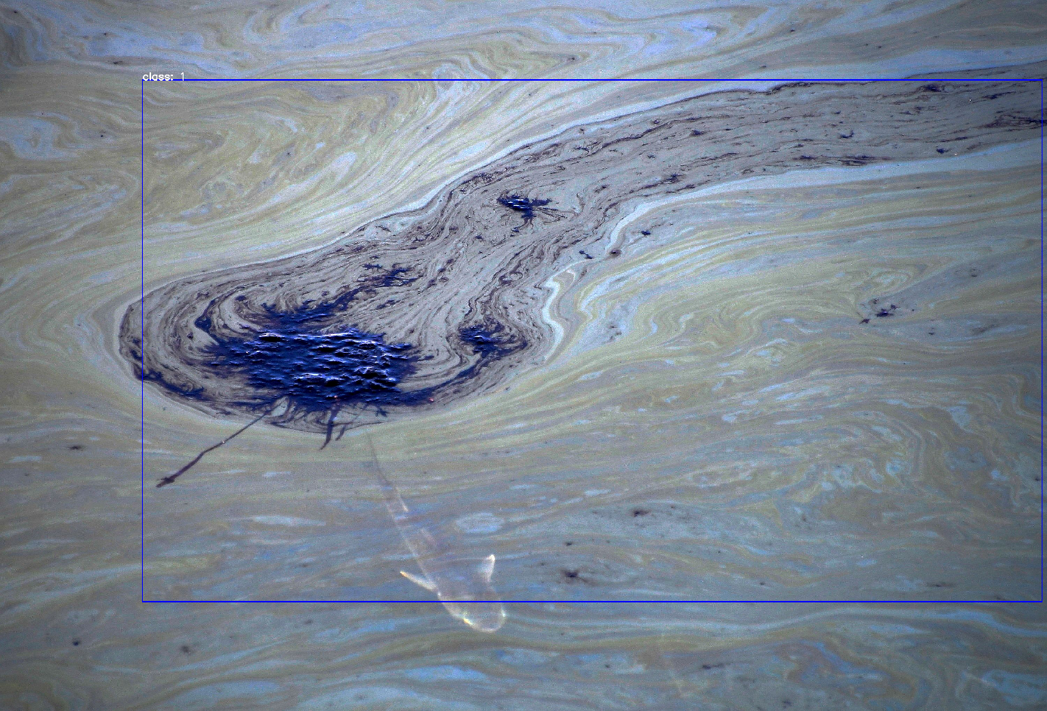
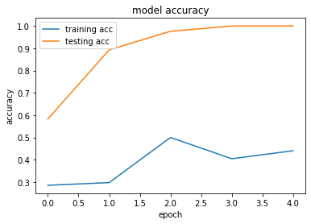
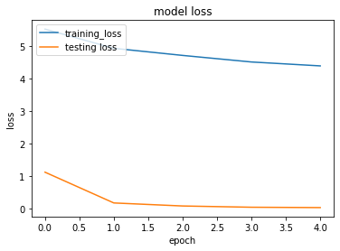
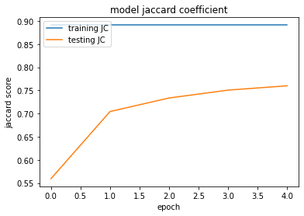
EVALUTION AND RESULTS
Predicted Image
We were able to successfully detect oil spills by classifying images with an accuracy of 92%, with a loss of 4.3.

Slide 21
MODELING
Image Segmentation Model | U - Net
Image Size | 256 X 256 X 1
Optimizer | Adam
Learning rate | 3e-5
Activation function | Sigmoid
Loss function | Binary Cross Entropy
epochs | 10
Batch size | 30
Notes:
Optimization – rrecognition, adam, loss, accuracy, outputs,

Slide 22
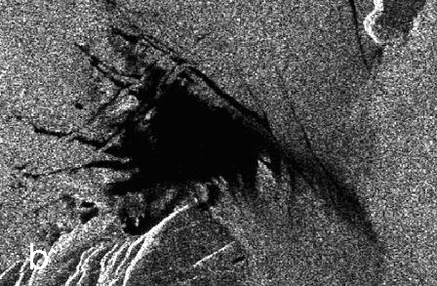

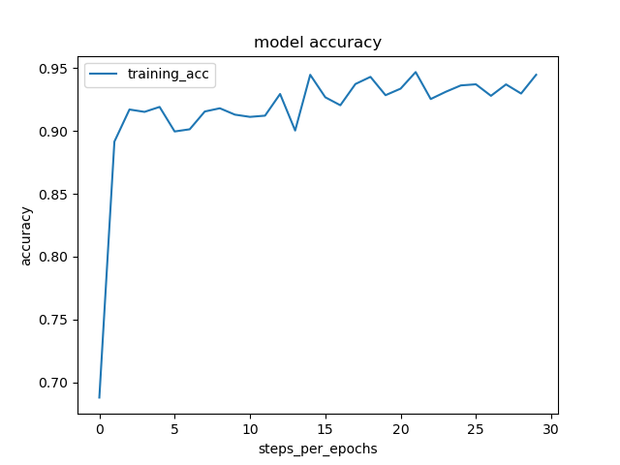
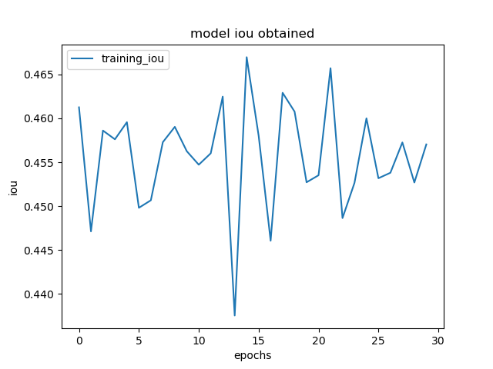
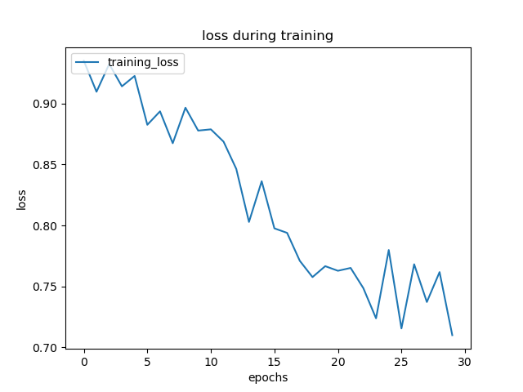
EVALUTION AND RESULTS
Test Image
Predicted Image
We were able to segment images with mIoU of 0.701, accuracy of 94.4%.

Slide 23
FUTURE ENHANCEMENT
The dataset can be enhanced by having inputs of the area covered by the satellite in the image, which would help in calculating the spread of the oil spill.
Knowing the location of the SAR image, nearby coast guard can be alerted.
Modelling can be enhanced with different combinations of algorithms.

Slide 24

CONCLUSION
Oil spills have enormous impact on economy, employment, and transportation. Unfortunately, accidents occur, and spills reoccur more frequently. With the help of deep learning, this helps in faster identification of the oil spill and also in identification of the origin of the spill which helps in controlling the spread of spill and faster damage control is achieved.

Slide 25

THANK YOU!

